Slide 1
Café Management
UNDER THE GUIDANCE OF
Mrs. Indrakka mali
SUBMITTED BY:
Narmidha M
Revathy B

Slide 2
INTRODUCTION
The café management ordering system that I am proposing here, greatly simplifies the ordering process for both the customers and the cafe.
System presents an interactive and up-to-date menu with all available options in an easy-to-use mannercustomers can choose one or more items to place an order which will land in the payment.
Customers can view all the order details in the cart before checking out. At the end, customer gets order confirmation details. Once the order is placed it is entered in the database and retrieved in pretty much real time. This allows café Employees to quickly go through the orders as they are received and process all orders efficiently.
🍝
🍝

Slide 3

PROJECT OBJECTIVE
The purpose of our application is to provide food lovers with a convenient and user-friendly platform to browse and order food online.
This website aims to bridge the gap between foodie and a wide variety of food providers. It is accessible on multiple food type, including Veg, Non-veg, Alternate, Dishduo.
Ensuring a seamless and efficient order experience that enhances user satisfaction and loyalty.

Slide 4
TECHNOLOGY USED
Spring
Spring Boot is an advanced application framework, designed to simplify the development of Java applications by providing built-in tools and libraries
JAVA
Java is an object-oriented programming (OOP) language, which means it supports the principles and concepts of object-oriented programming.
JaVa
Spring
HTML
angular
HTML, which stands for HyperText Markup Language, is the standard markup language used for creating and structuring web pages.
ANGULAR
Angular is a TypeScript-based framework that uses HTML, CSS, and JavaScript to build robust and scalable single-page applications.
JAVASCRIPT
JavaScript is a widely used programming language primarily used for web development.

Slide 5
PROPOSED SYSTEM
The platform for customers to browse proposed system of an online online Food order system aims to provide a seamless and user-friendly, select, and order products conveniently from the comfort of their homes.
Given comprehensive full-stack project combines the power of Java Spring Boot, Hibernate, MySQL, and Angular.
This system aims to address the challenges of modern web development by utilizing Java Spring Boot for rapid backend development, Hibernate for seamless communication with the MySQL database, and Angular for creating dynamic and interactive user interfaces. By leveraging these technologies, we can deliver a robust, scalable, and user-friendly application that meets the demands of today's web development landscape.

Slide 6

REQUIRED SPECIFICATIONS
HARDWARE CONFIGURATION | SOFTWARE CONFIGURATION
Operating System : Windows 10 and above | Software IDE: Eclipse,, MySQL, VS Code.
Hard Disk: 500 GB | Language: JAVA, Type Script, HTML, CSS
RAM: 8 GB | Front End: Angular,
 | Back End: Spring Boot, MySQL.

Slide 7
MODULES
01
ADMIN :-
Registration and Login.
02
CUSTOMER :-
SignUp and Login.
03
ORDER LIST :-
Order id Order date User Id User Name Meal Plan category and product price Duration Quantity Grand Total Operation
04
MEAL PLANE:-
Customer can add favorite product . after select type of food
05
PAYMENT :-
Customer has to pay for placing of order.

Slide 8
SPRING NOTATATIONS
@Controller : | The @Controller annotation indicates that a particular class serves the role of a controller. Spring Controller annotation is typically used in combination with annotated handler methods based on the @RequestMapping annotation.
@Autowired | The @Autowired annotation provides more fine-grained control over where and how auto-wiring should be accomplished. Autowiring feature of spring framework enables you to inject the object dependency implicitly. It internally uses setter or constructor injection.
@RequestMapping | The @RequestMapping is one of the most common annotation used in Spring Web applications. This annotation maps HTTP requests to handler methods of MVC and REST controllers.
@Entity | The @Entity annotation specifies that the class is an entity and is mapped to a database table.
@Table | The @Table annotation is used to create a table in database.
@JoinColumn | The @JoinColumn is used to specify a column for joining an entity association or element collection.

Slide 9
SPRING NOTATATIONS
@PutMapping | The @PutMapping is used for update the records.
@PostMapping | The @PostMapping is used to create a resource Mapping.
@GetMapping | The @GetMapping is used to read all the inserted records.
@DeleteMapping | The @DeleteMapping is used to delete the records.
@PathVariable | The @Path Variable annotation is used to extract the value from the URL.
@RequestParam | The @RequestParam annotation is used to read the form data and bind it automatically to the parameter present in the provided method.

Slide 10
SPRING NOTATATIONS
@Request Body | The @RequestBody annotation is applicable to handler methods of spring controller. spring should deserialize a request body into an object.
@OneToOne Mapping | The @OneToOne JPA annotation is used to map the source entity with the target entity, Hibernate maps the tables in your database to the Entity classes in your application.
@OneToMany Mapping | The @OneTo-Many relationship between table A and table B indicates that one row in a table A link to many rows in table B but one row in table B links to only one row in table A.
@ManyToOne Mapping | The @Many-to-One mapping means that many instances of this entity are mapped to one instance of another entity.
@ExceptionHandler | The @ExceptionHandler is an annotation used to handle the specific exceptions and sending the custom responses to the client.
@ControllerAdvice | A controller advice allows you to use exactly the same exception handling techniques but apply them across the whole application, not just to an individual controller. You can think of them as an annotation driven interceptor.

Slide 11
ADVANTAGES
Today, more than ever, people can easily order online thanks to the smart phones and tablets.
Whether on a break, stuck in traffic, or riding the bus, virtually anyone will place an order quickly.
In fact, this is a better, and highly desirable alternative to waiting until getting home and placing the order over the phone.

Slide 12
CONCLUSION
The Cafe management system will be helpful for the restaurant to increase the scope of the business by helping users to give order through this method.
🥧

Slide 13
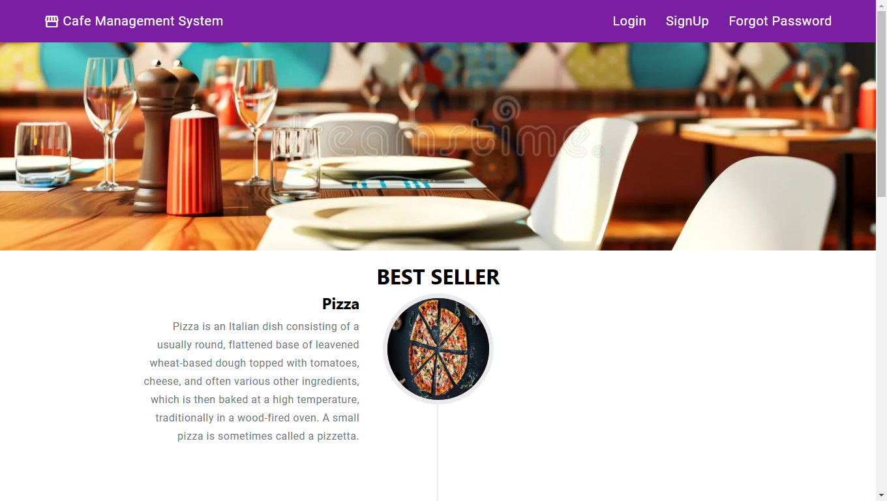
Home page

Slide 14
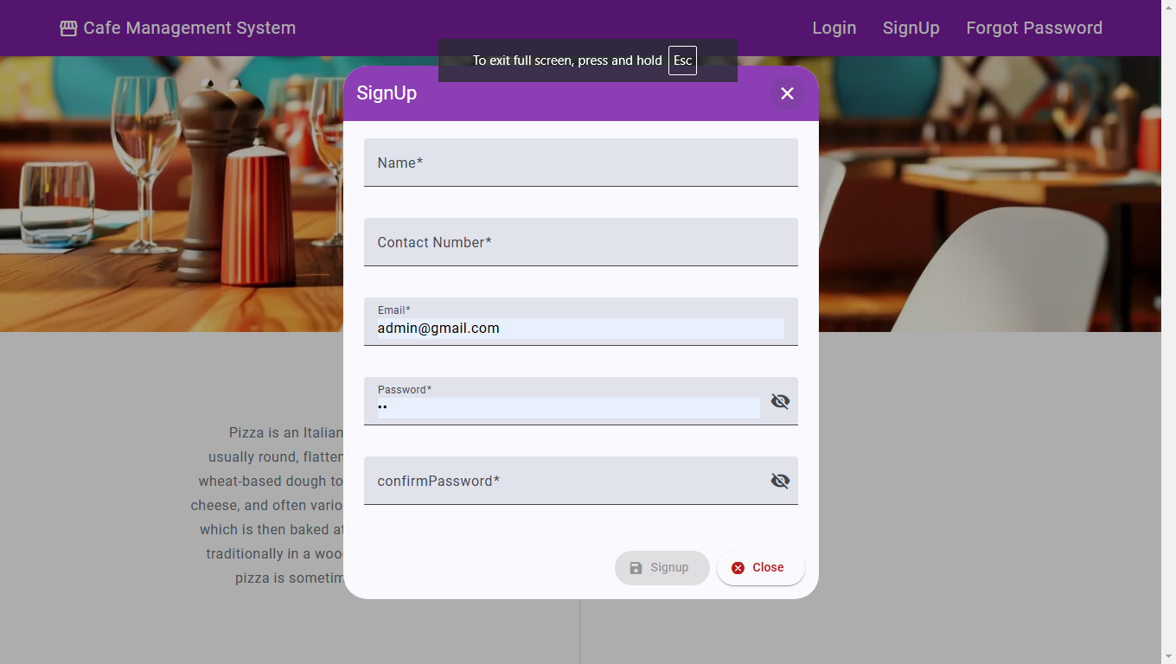
Sign up

Slide 15
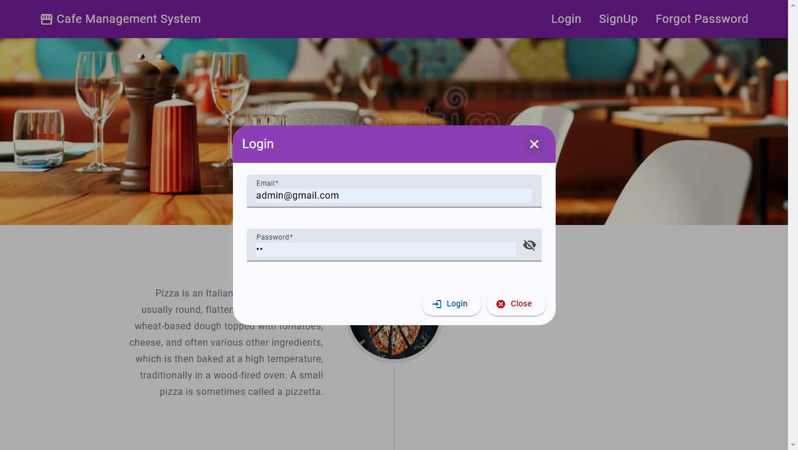
MY ORDER LIST

Slide 16
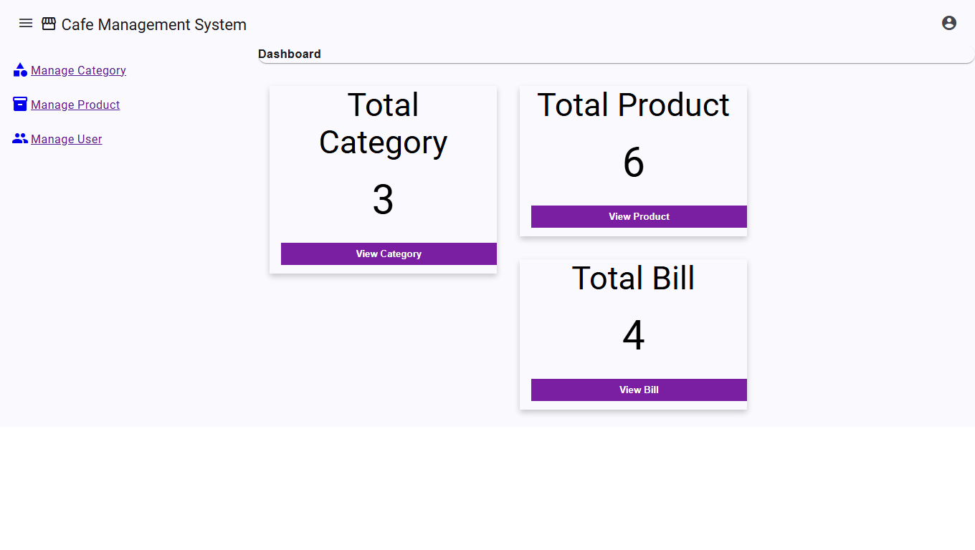
Admin page

Slide 17
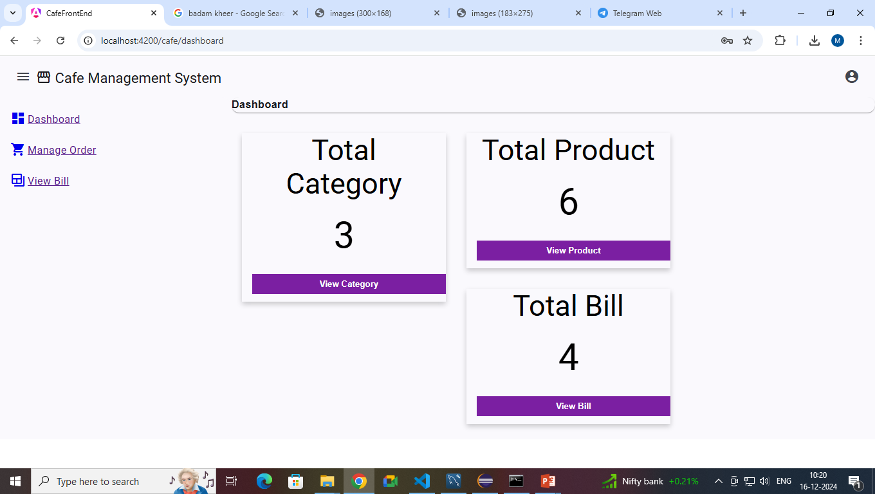
User page

Slide 18
THANK YOU

